Slide 1
Gas Agency Administration System
MINI PROJECT
Aradhya Priyadarshi 2000270110021
Nishchal Arya 2000270130114
B.Tech IT – 2
Ajay Kumar Garg Engineering College, Ghaziabad

Slide 2
Contents
Objective Of The Project
What really is a Gas Agency?
What is the need of gas Agency?
How to get INDANE Gas connection offline?
System Requirements
Turbo C++
Gas Agency Administration System
Bibliography
Project Link
Conclusion

Slide 3
Objective Of The Project
The proposed project on gas agency administration system is an effort to solve the various problems in gas transaction in liquefied gas agencies. The implementation of the project establishes a systematic and reliable distributing service along with a well-maintained stock administration.
Gas Agency administration system is designed to handle all the primary information required to calculate such as – final bills, total sales during the entire day.

Slide 4
What really is a Gas Agency ?
Gas Agency is a platform which is provided by the various GAS providing companies such as INDANE Gas, Bharat Petroleum, OIL, etc. to its customers in their various cities over the nation so that an ordinary people can book cylinder/LPG Gas from them.
Distributors around the nation purchase the dealership of the particular Gas Providing company so that they can provide their services all over the nation.

Slide 5
What is the need of GAS Agency ?
Gas Agency is the place where ordinary people come to order a new refill for their domestic LPG . Without Gas Agency in a city zone, the distribution system protocols set by the OIL providing companies will get disturbed as a result of which it can result into the mismanagement of the gas resource of the Government of India. That is the reason why the availability of the Gas Agency in a city is very much necessary in our day to day life.

Slide 6

How to get a New INDANE Gas Connection Offline ?
Please visit the nearby INDANE GAS distributor office in your area.
You will be asked to fill a form to register yourself as a new customer.
Please carry the necessary supporting documents like a valid address proof, photographs, and identity proof.
Please note that that the distributor may visit your residence for an inspection of the gas stove you use once you submit the application with the supporting documents and pay the prescribed fees.
Upon successful verification, you will be issued the domestic gas cylinders.

Slide 7


System Requirements
The following system requirements are needed in order to run Gas Agency Software successfully in a system.
Windows 7 or Higher
4 GB RAM
10 GB HDD or SSD

Slide 8
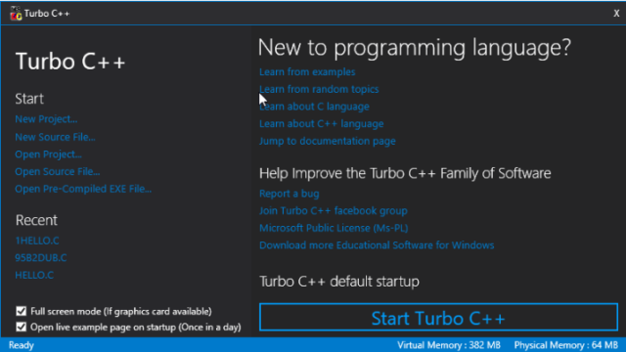
Turbo C++ Turbo C++ is a C++ IDE which is used by the programmers to compile the .cpp code file into .exe executable file.

Slide 9
GAS AGENCY ADMINISTRATION SYSTEM

Slide 10
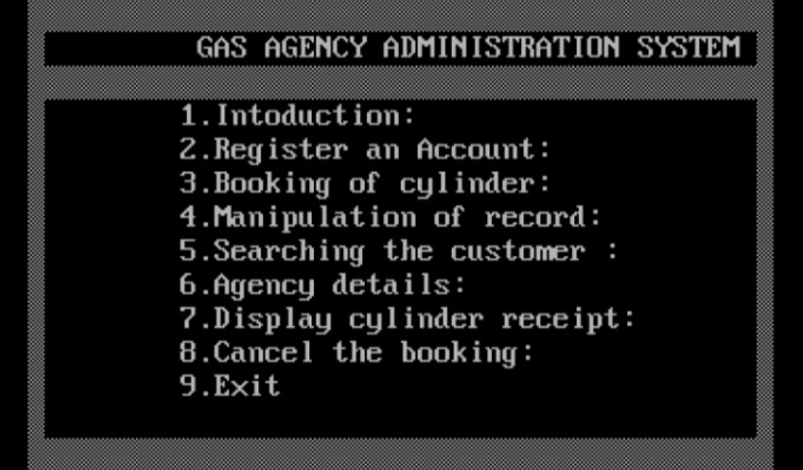
First Interface of the Project This is how dashboard of the Gas Agency will look like

Slide 11
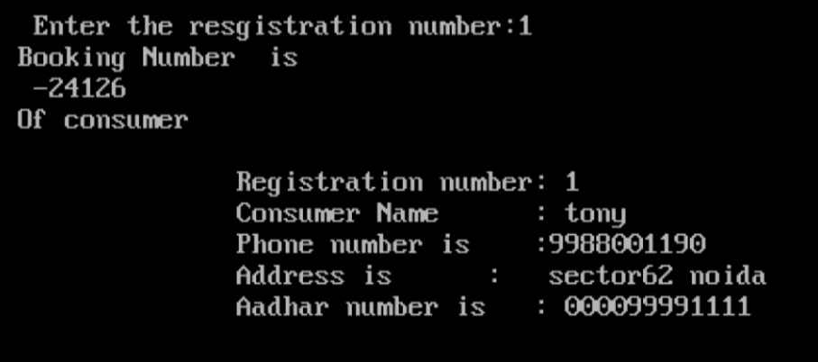
Registration Of Account Adding the new customer into the GAS AGENCY Database

Slide 12
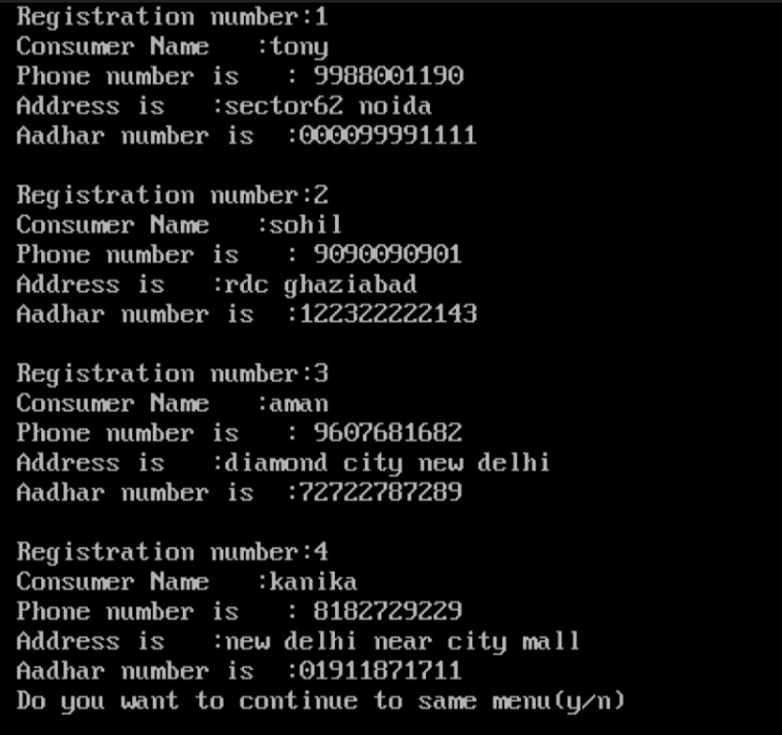
Continued…

Slide 13
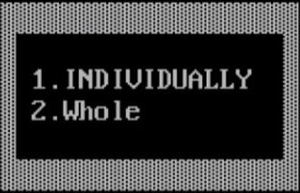
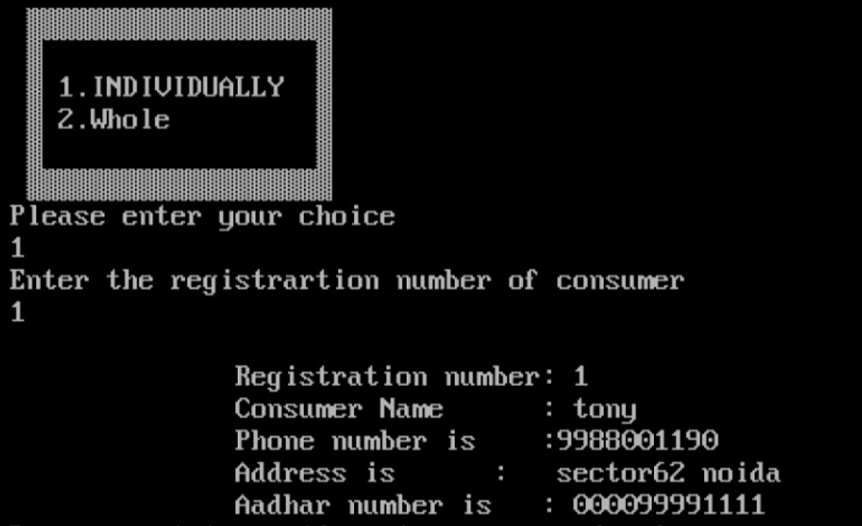
Searching the Customer Officer at the GAS Agency will search the customer into its database by entering the following details
Searching the Customer

Slide 14
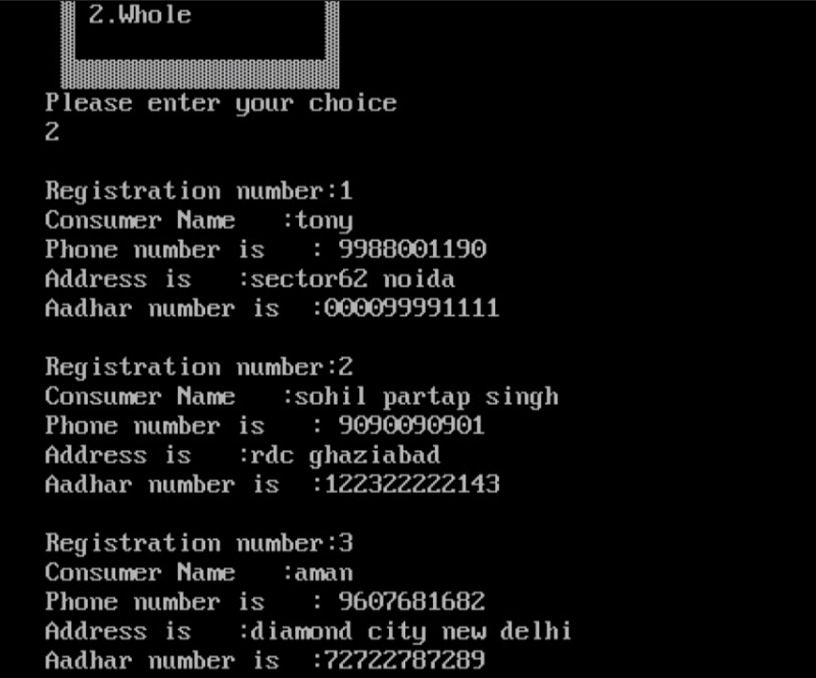
Continued…

Slide 15
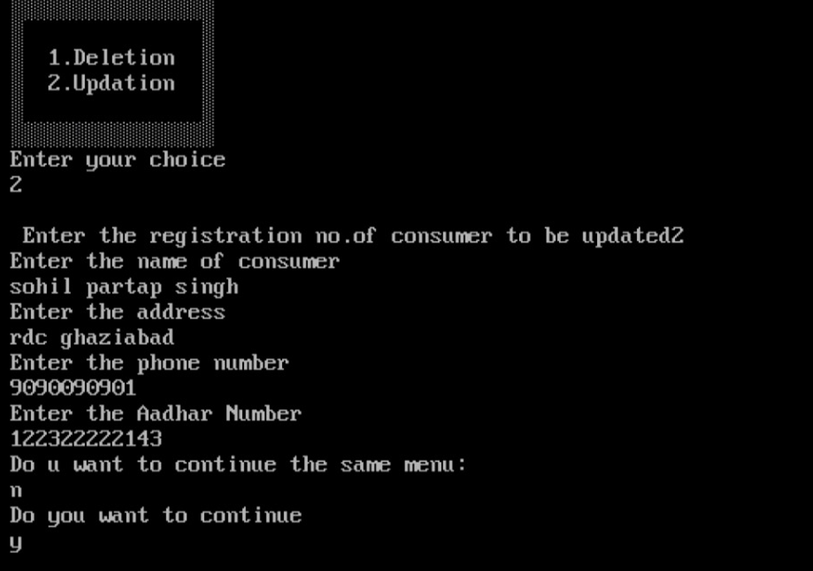
Manipulation Of Record In this section, we are concerned about the updation & deletion of the existing customer from the database of the GAS AGENCY database system.

Slide 16
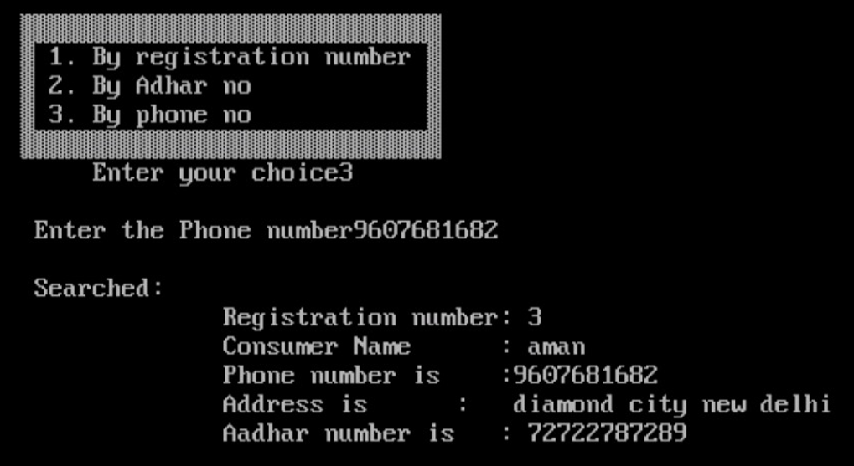
Booking The Cylinder Here , 3 options have been given to the customer to facilitate him/her on how he/she choose to book the cylinder.

Slide 17
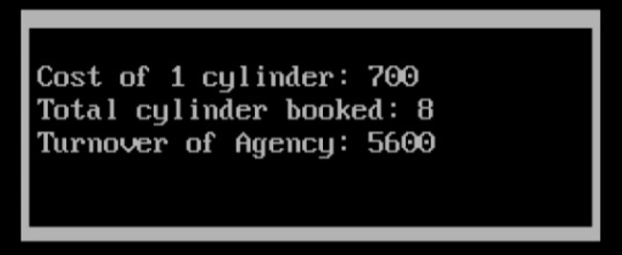
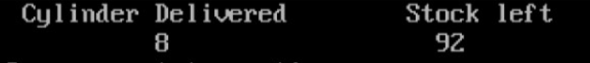
AGENCY DETAILS
Stock Status

Slide 18
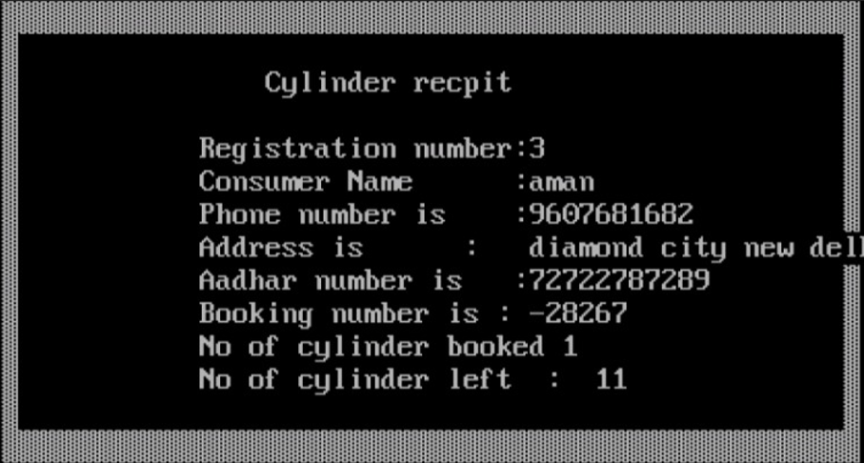
Generation of the Cylinder Receipt After completing all the formalities of the GAS Agency, the system will generate the receipt of the ordered new refill LPG.

Slide 19
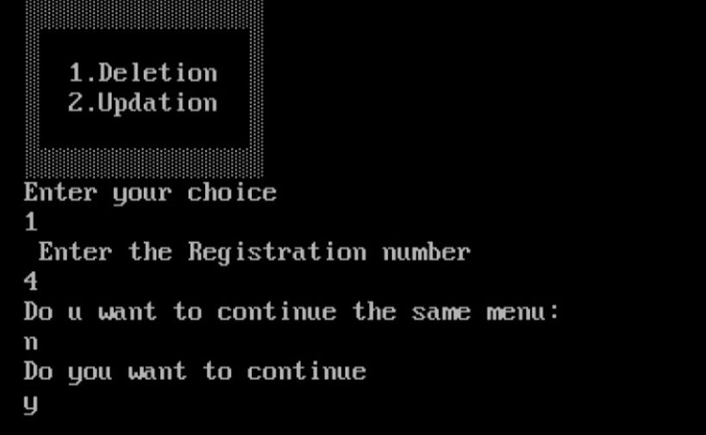
Deletion/Cancellation Cancelling the order is preferred when the customer does not want to fill the cylinder.

Slide 20

Project Link
The Gas Agency Administration System MINI PROJECT is uploaded on Google Drive. One can have access to it by clicking on this below link:
https://drive.google.com/drive/folders/1vqzGhTFKauON2gRAl7wg4kfZDCiZhDha?usp=sharing

Slide 21

Conclusion
Ø Gas Agency management database is an approach to effectively manage the data of the agency.
Ø A good database can be easily understood and the relationships between various customers and the management team can be easily depicted.
Ø The proposed gas agency management system is time saving and error free as compared to the traditional systems. This system attracts customers and also adds the efficiency of maintaining the gas cylinder ordering and billing.

Slide 22




Bibliography
The following sources have been taken into account in order to prepare this project:
INDANE Gas Agency
Beginning C++ 17
Cpp Reference
Unsplash
Office Stock Images
Google Images

Slide 23

MINI PROJECT Source Code

Slide 24
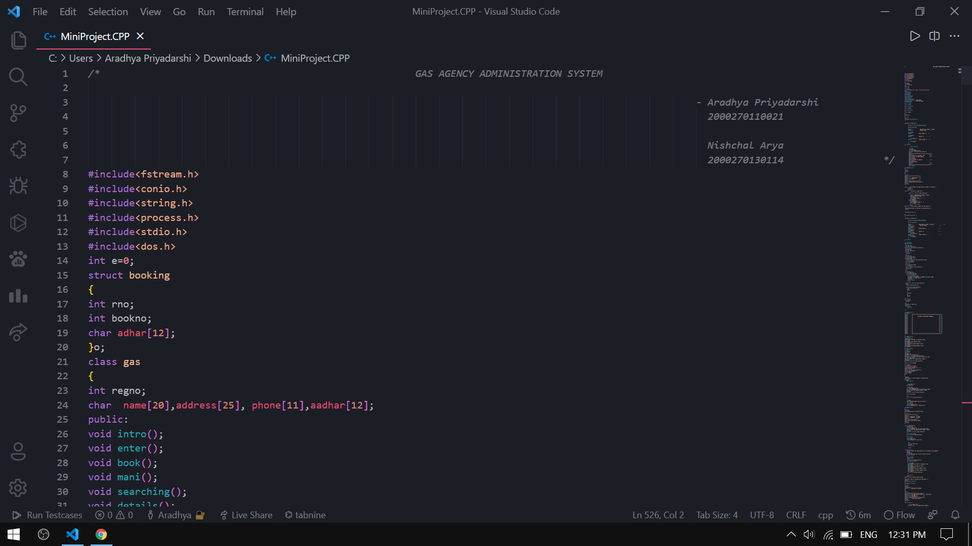

Slide 25
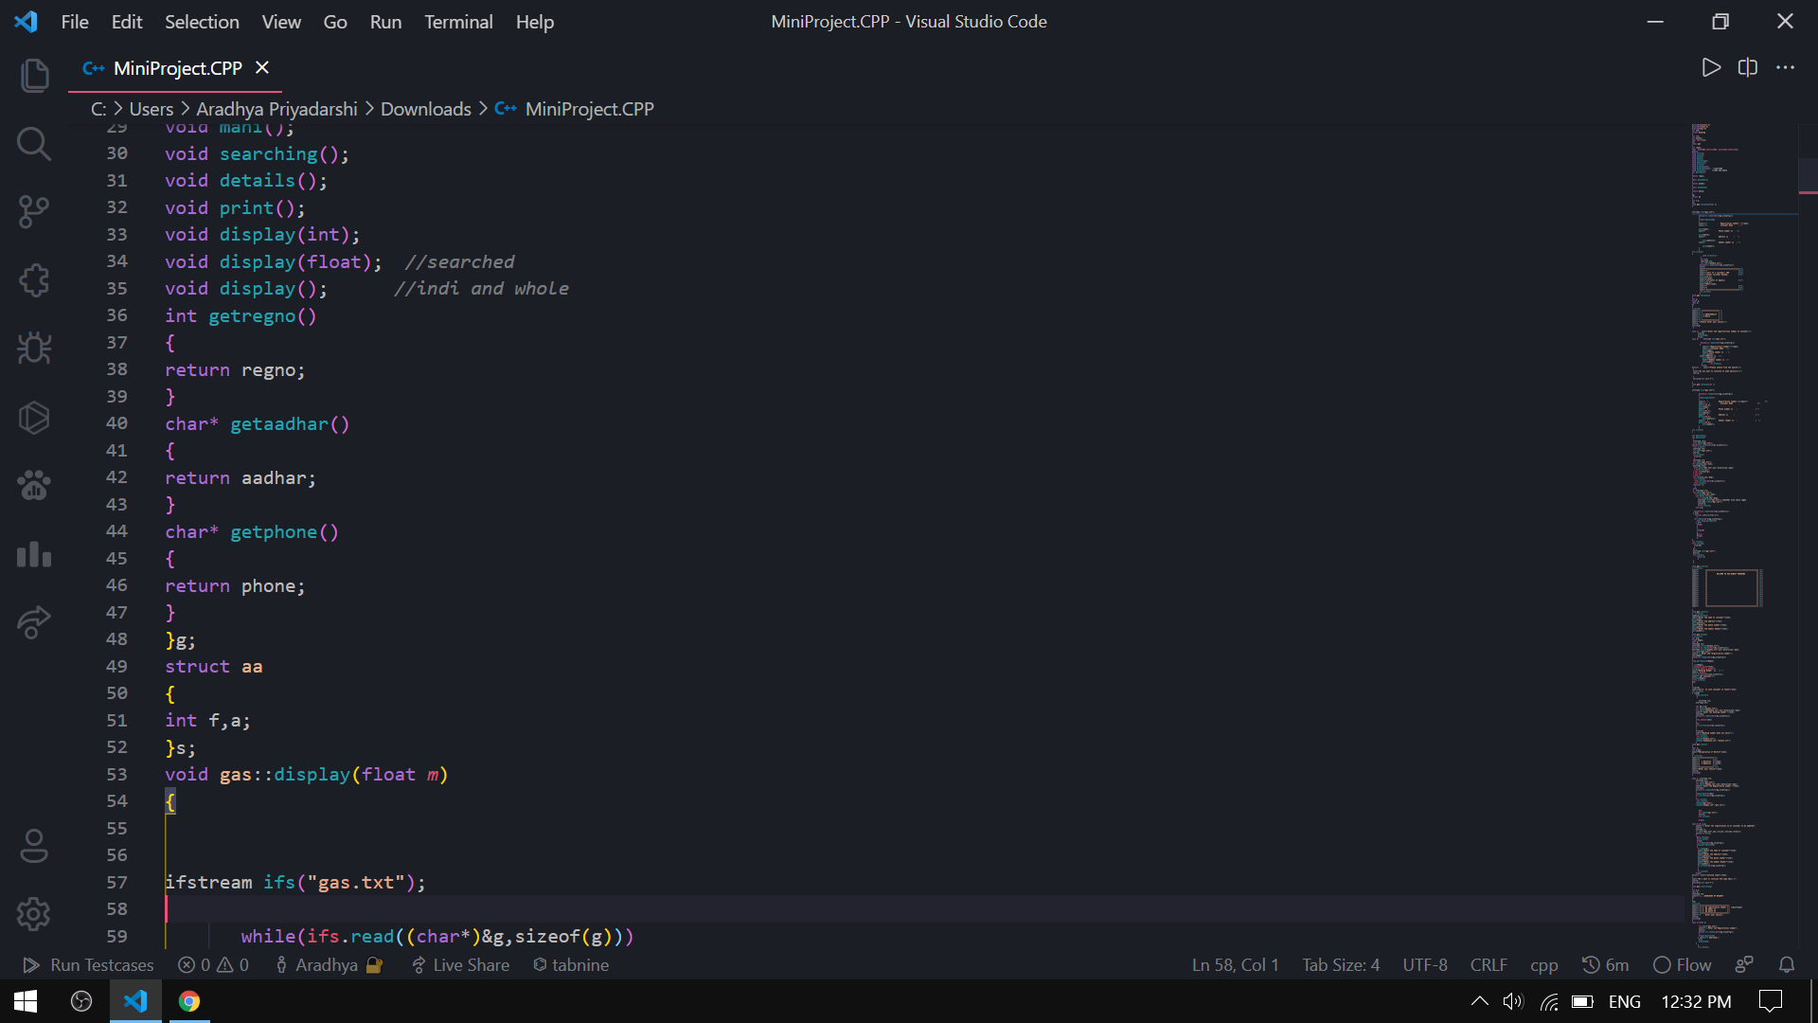

Slide 26
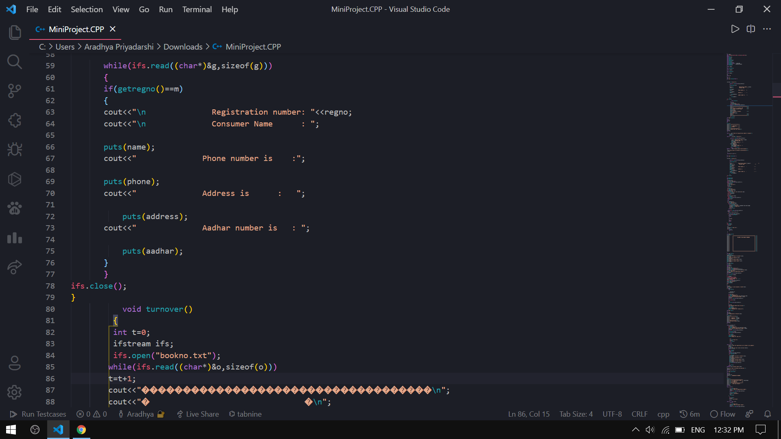

Slide 27
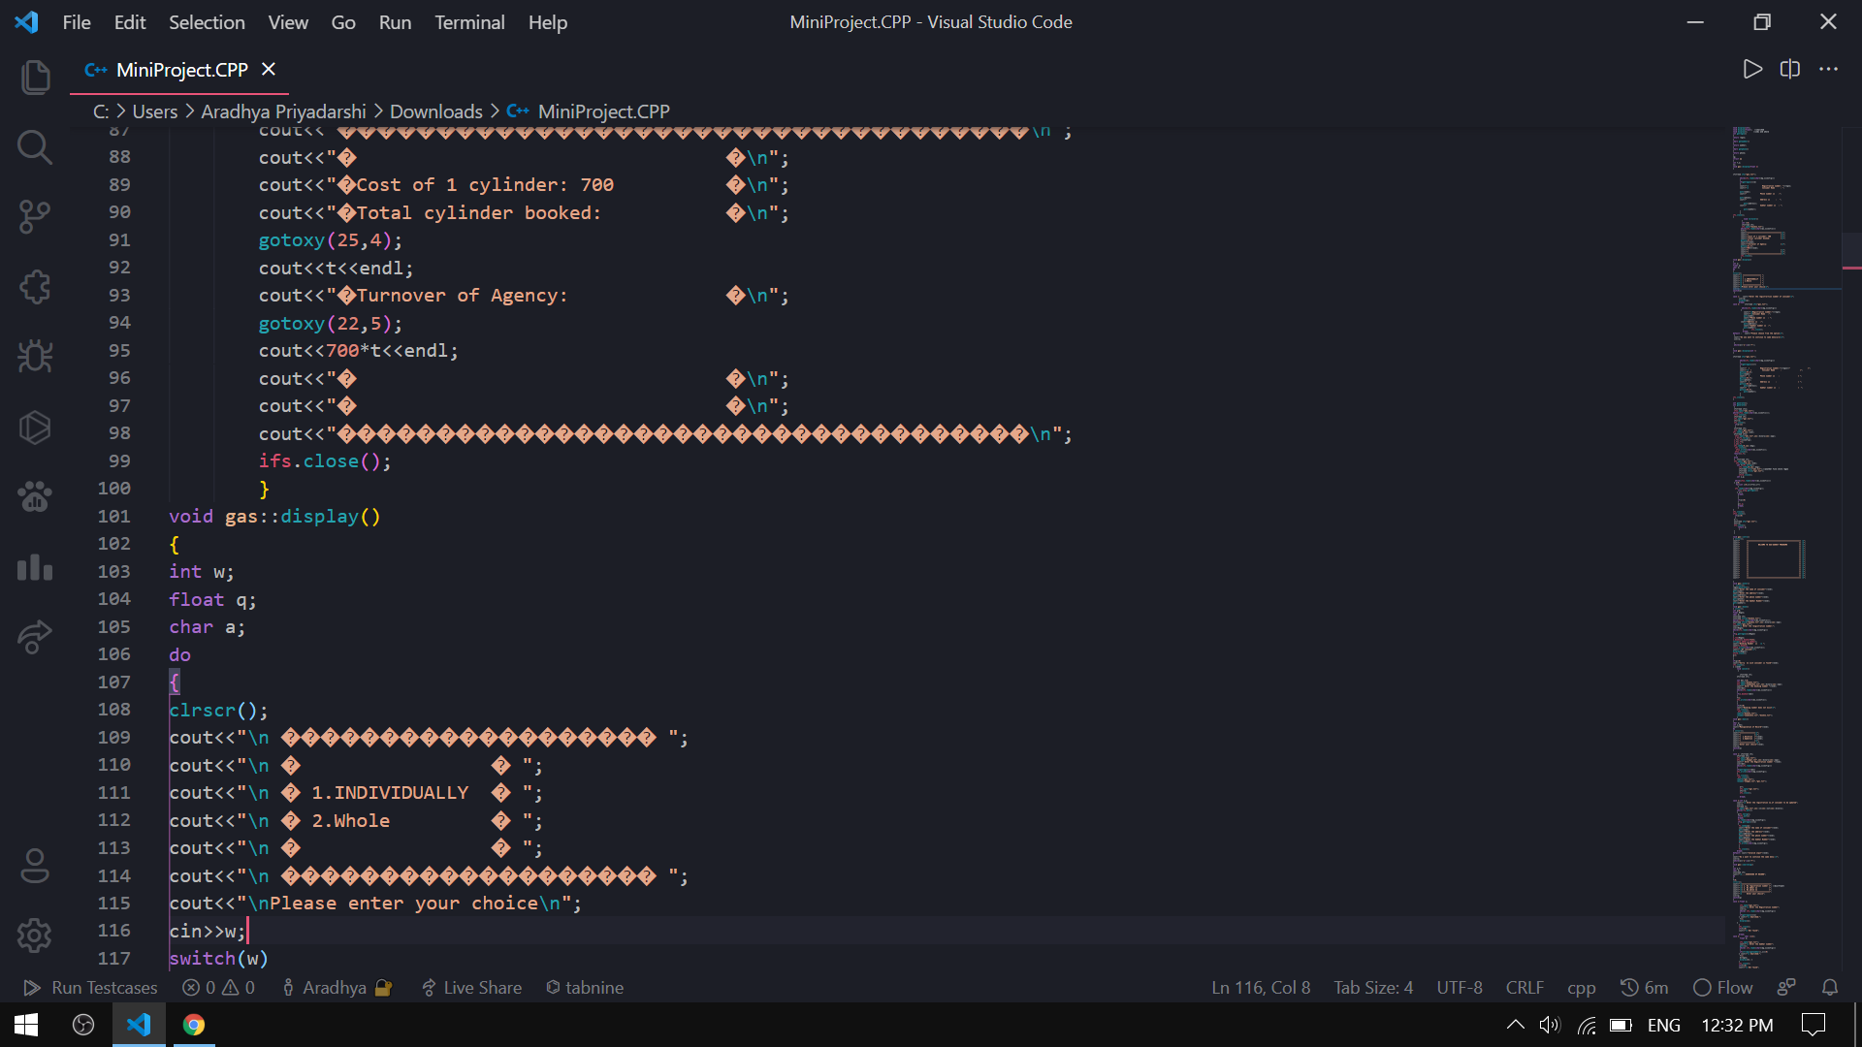

Slide 28
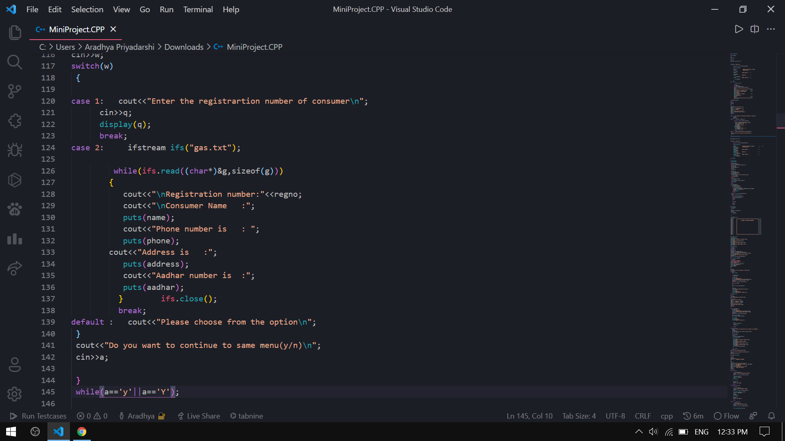

Slide 29
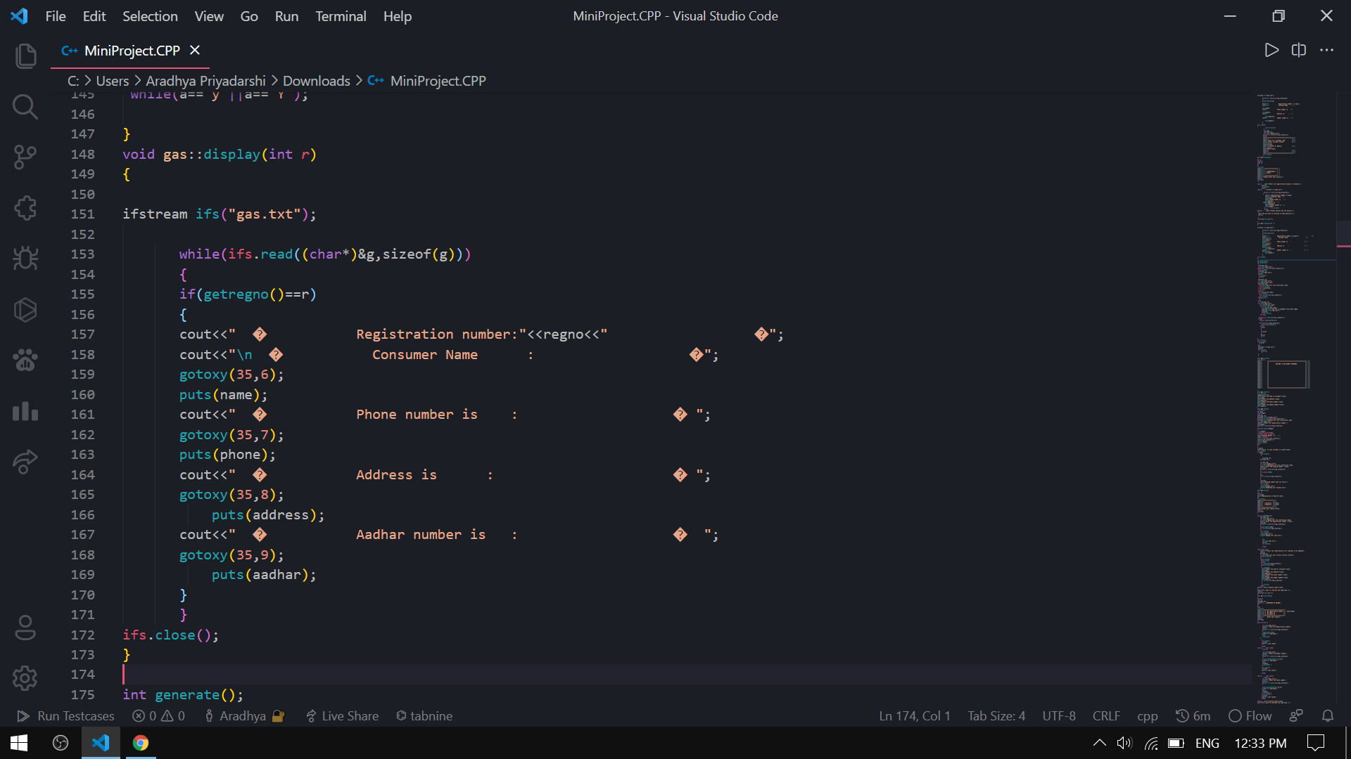

Slide 30
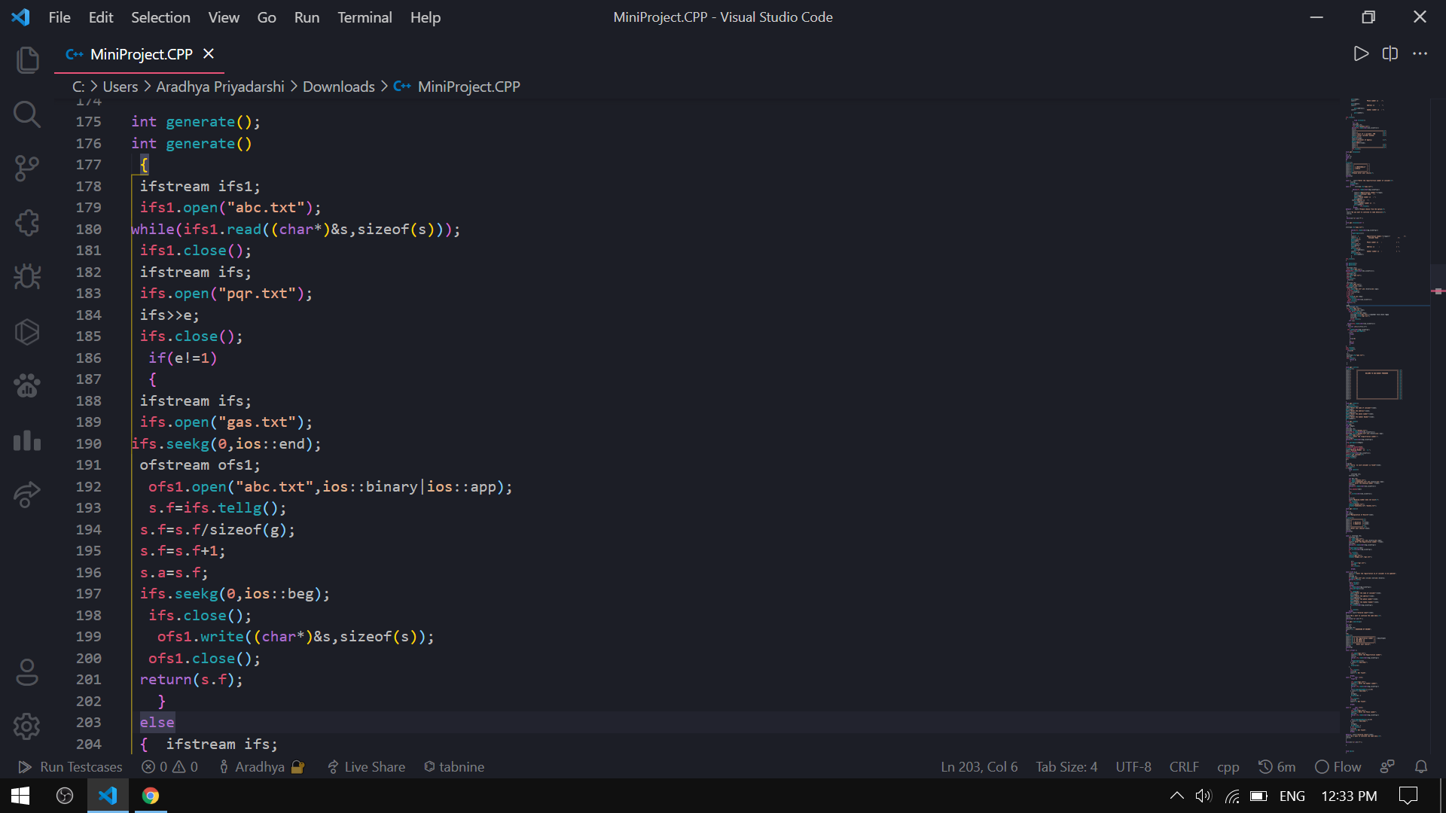

Slide 31
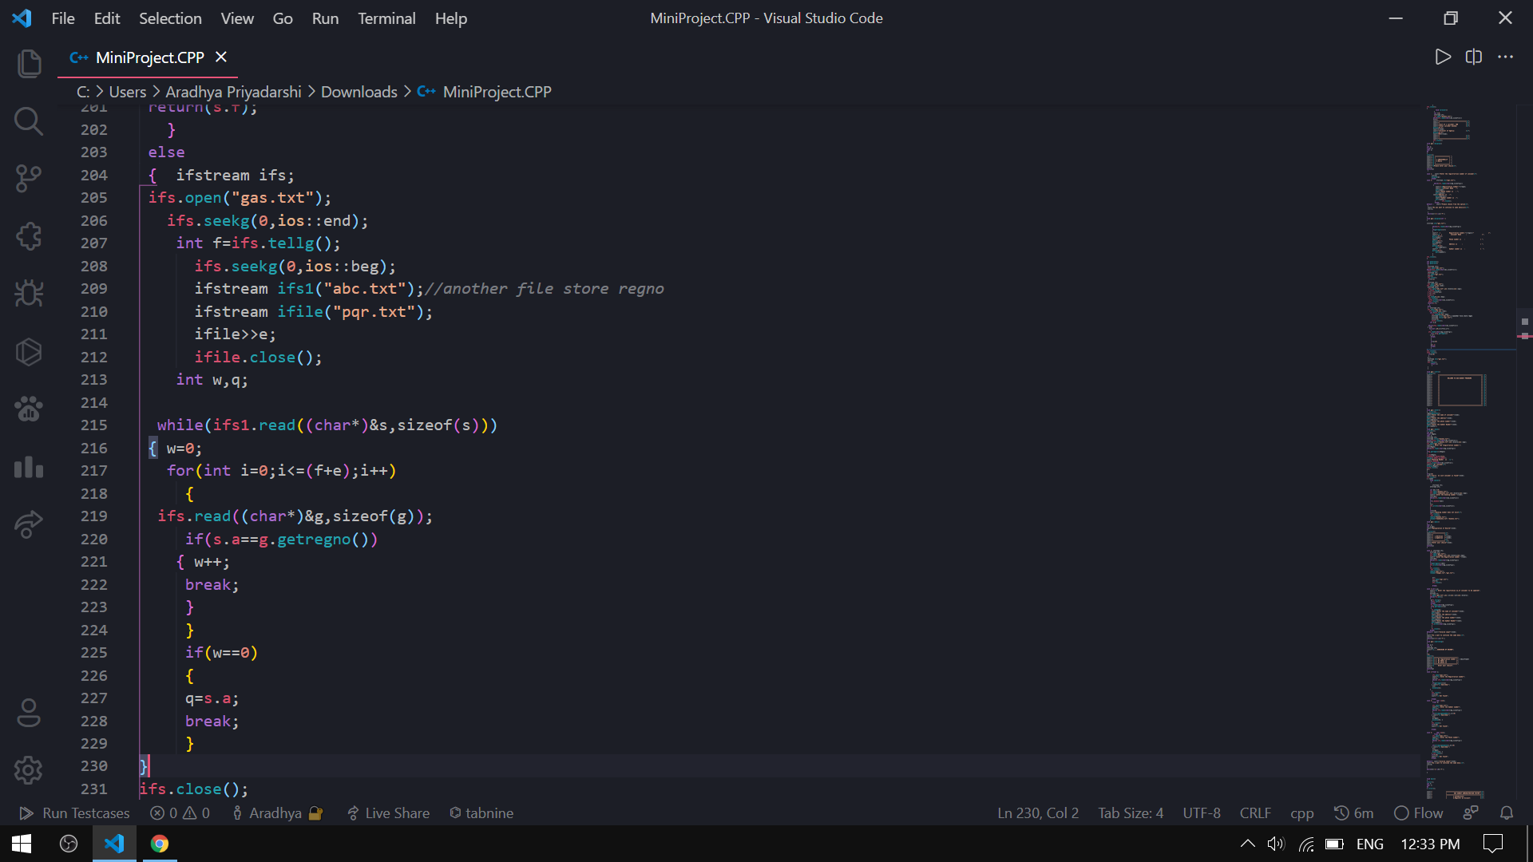

Slide 32
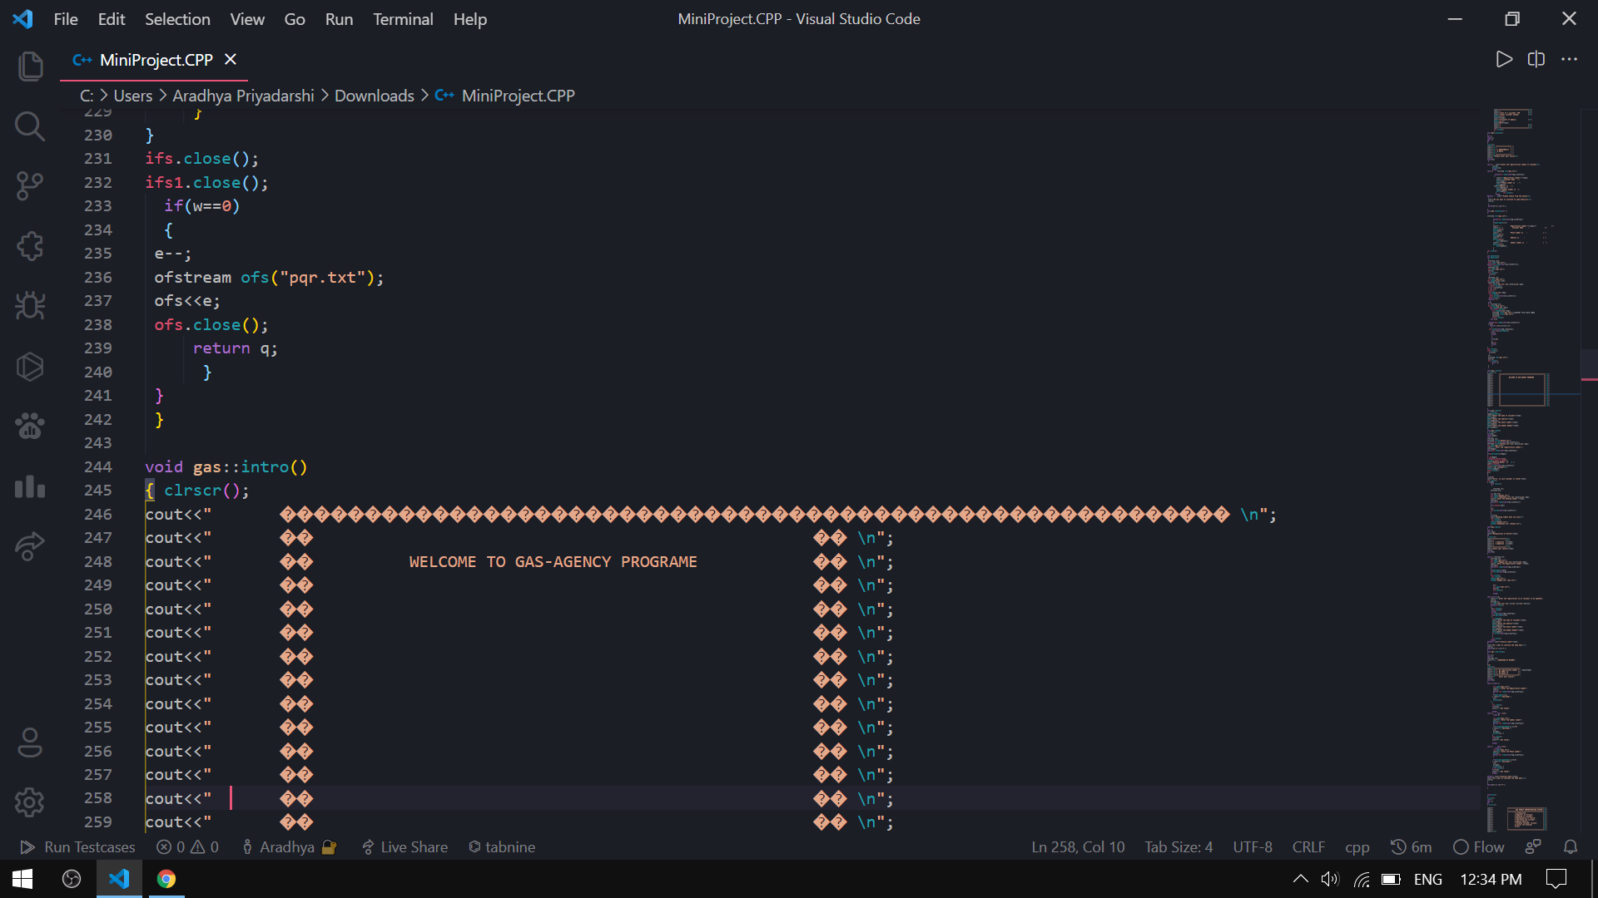

Slide 33
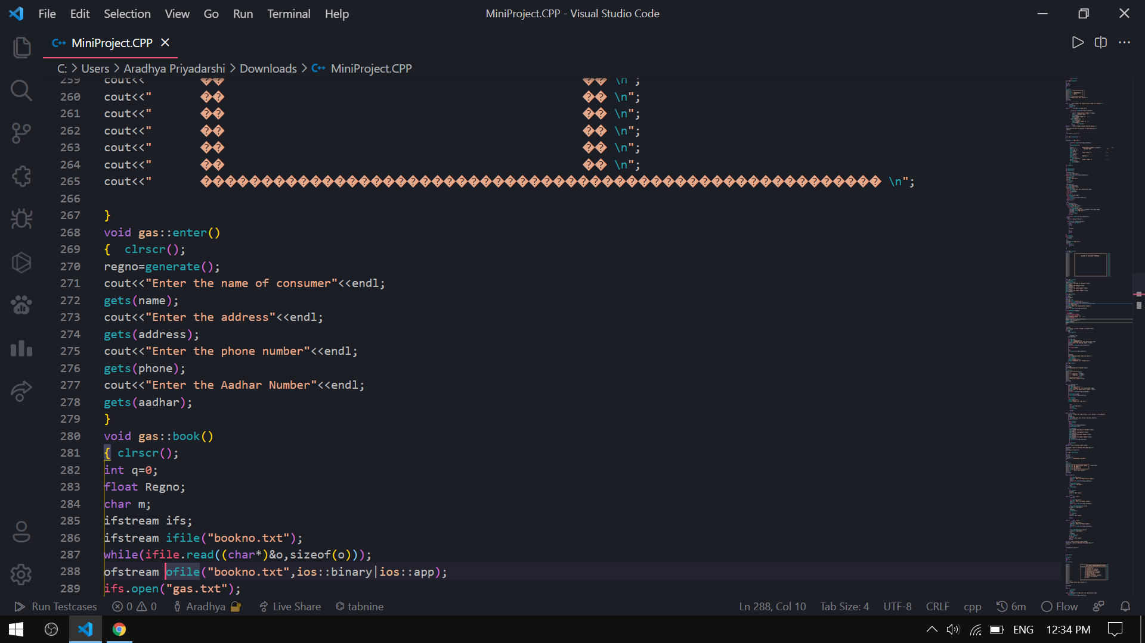

Slide 34
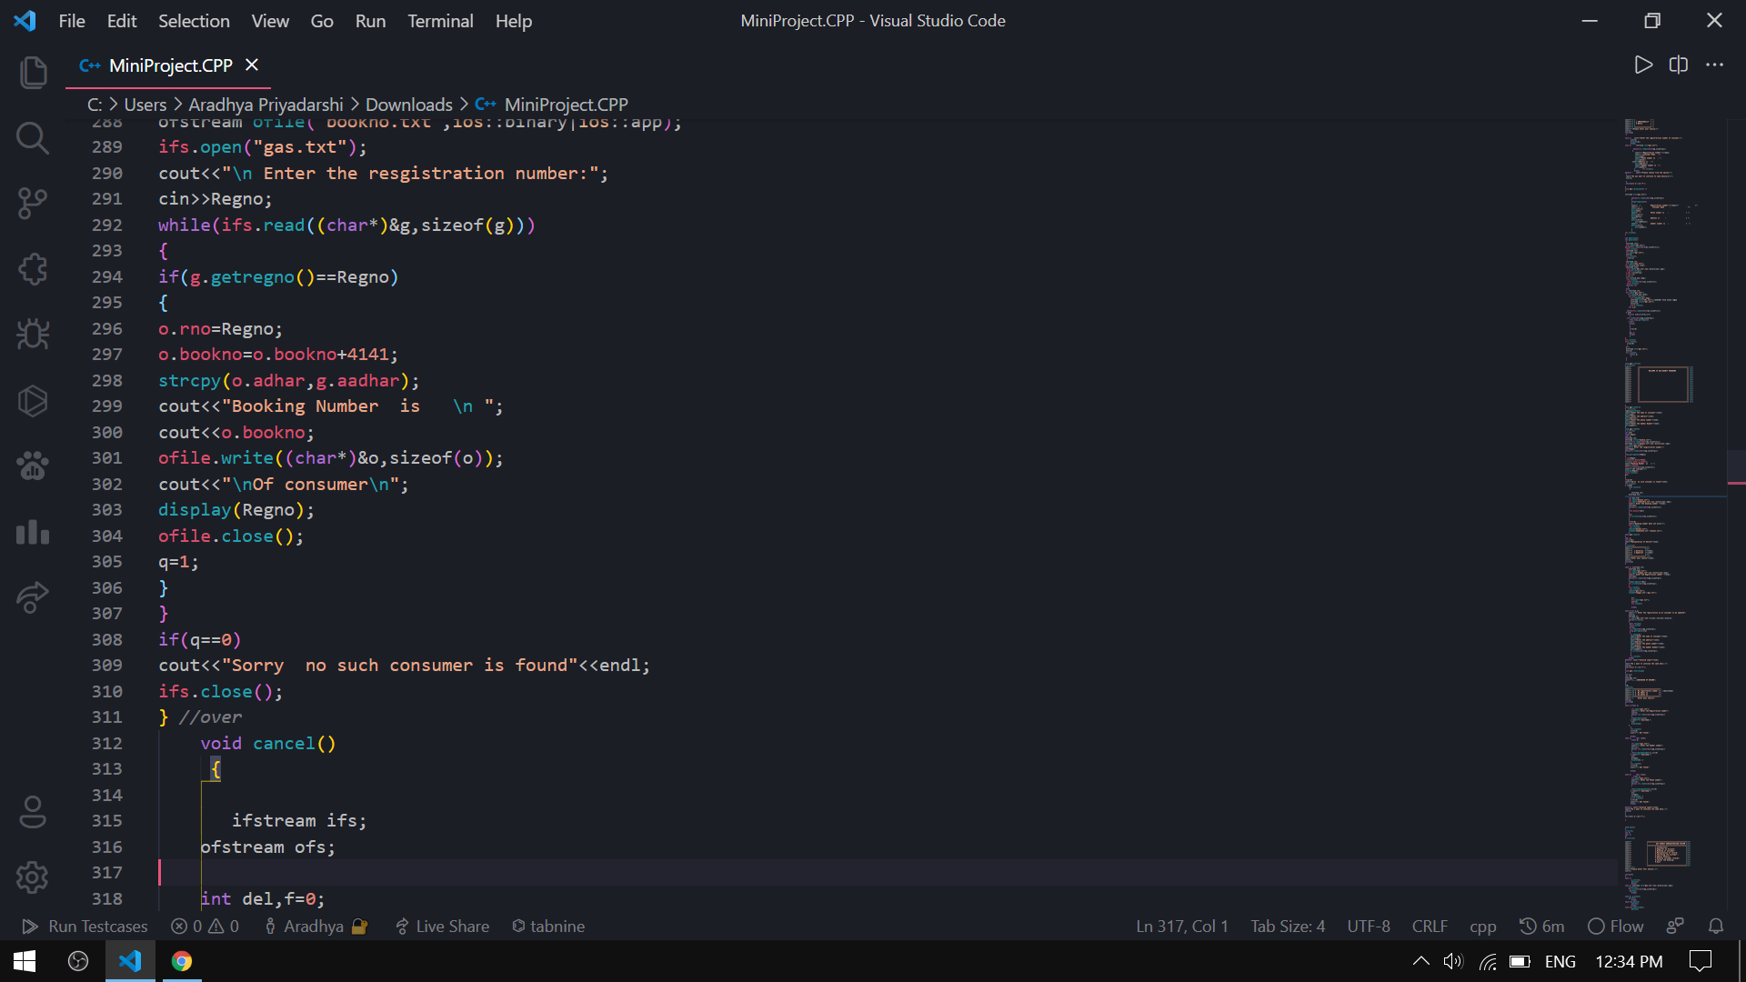

Slide 35
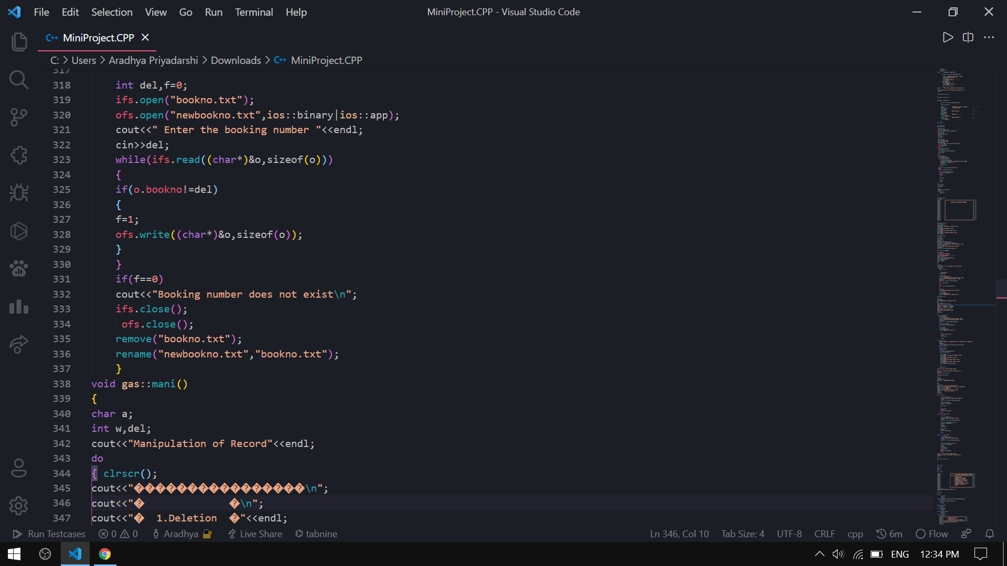

Slide 36
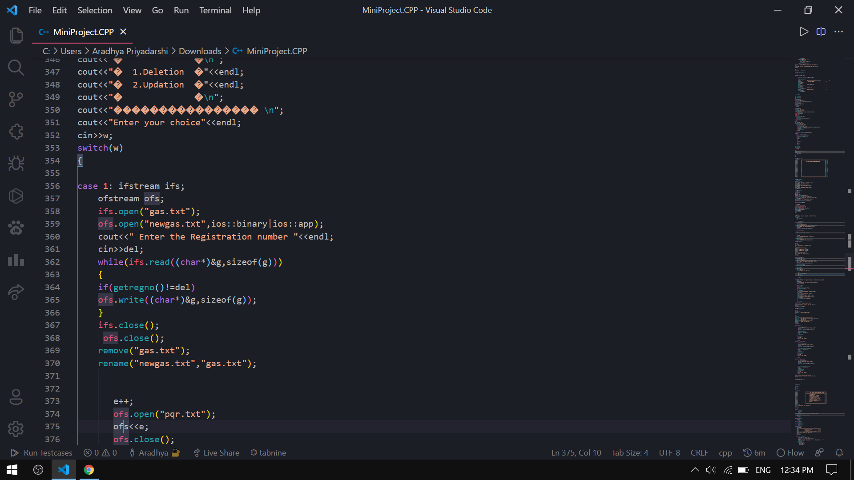

Slide 37
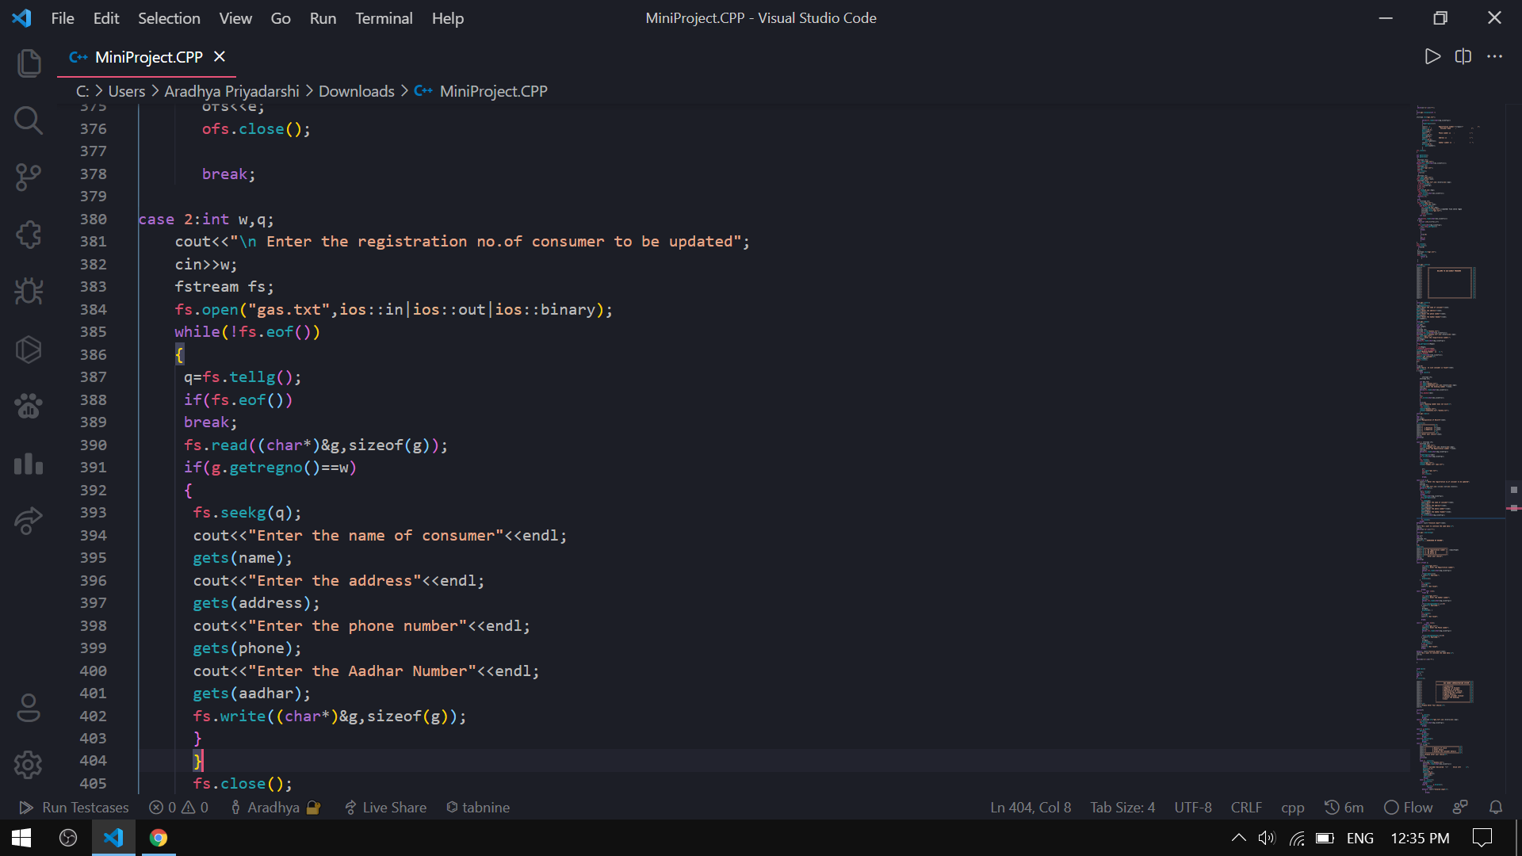

Slide 38
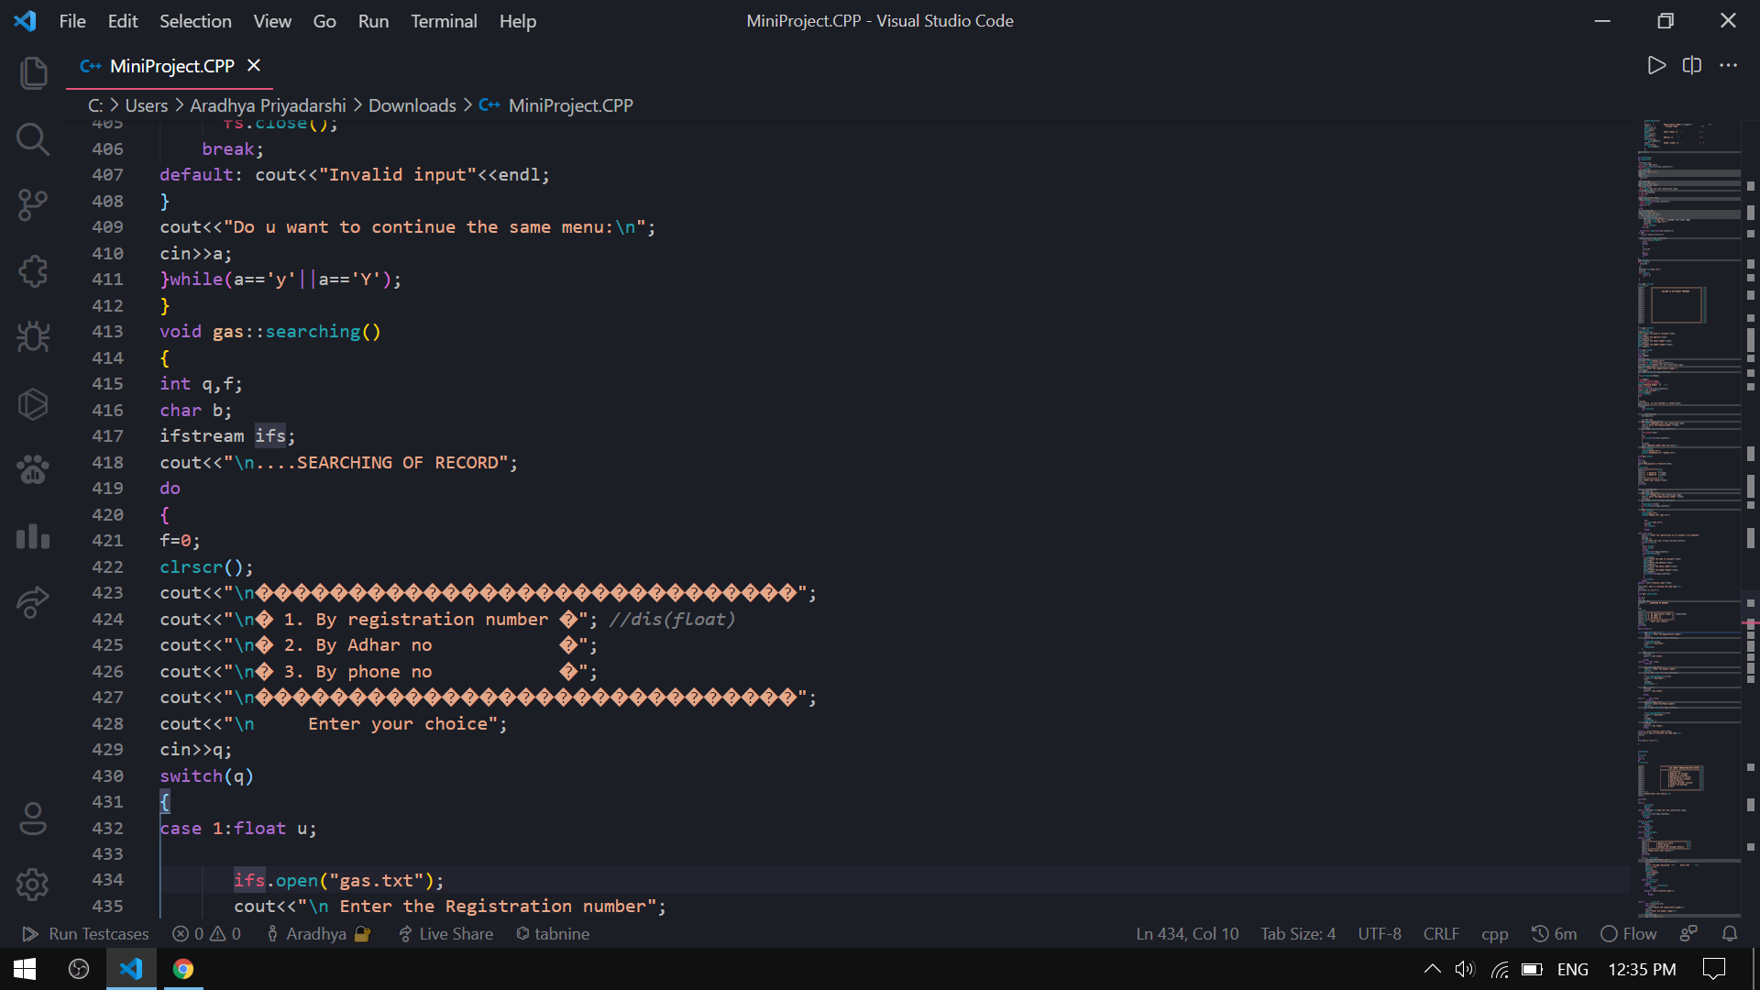

Slide 39
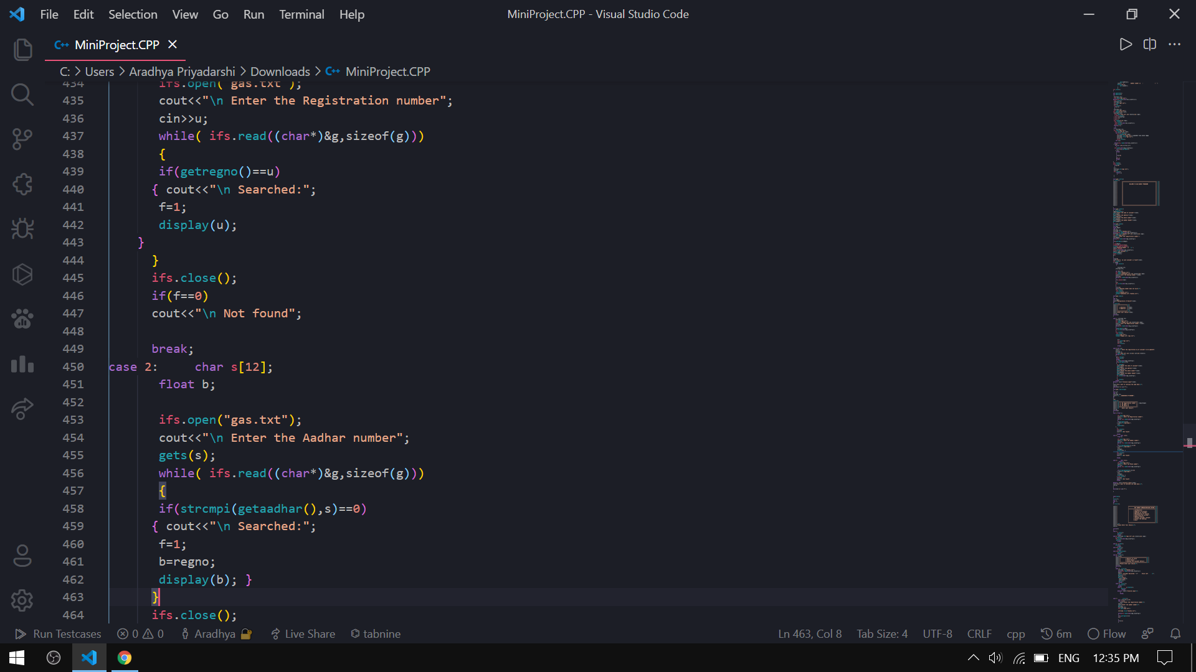

Slide 40
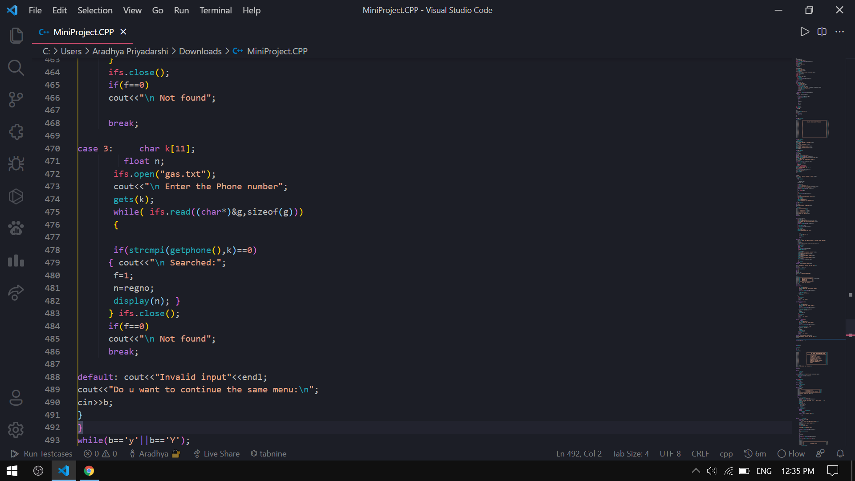

Slide 41
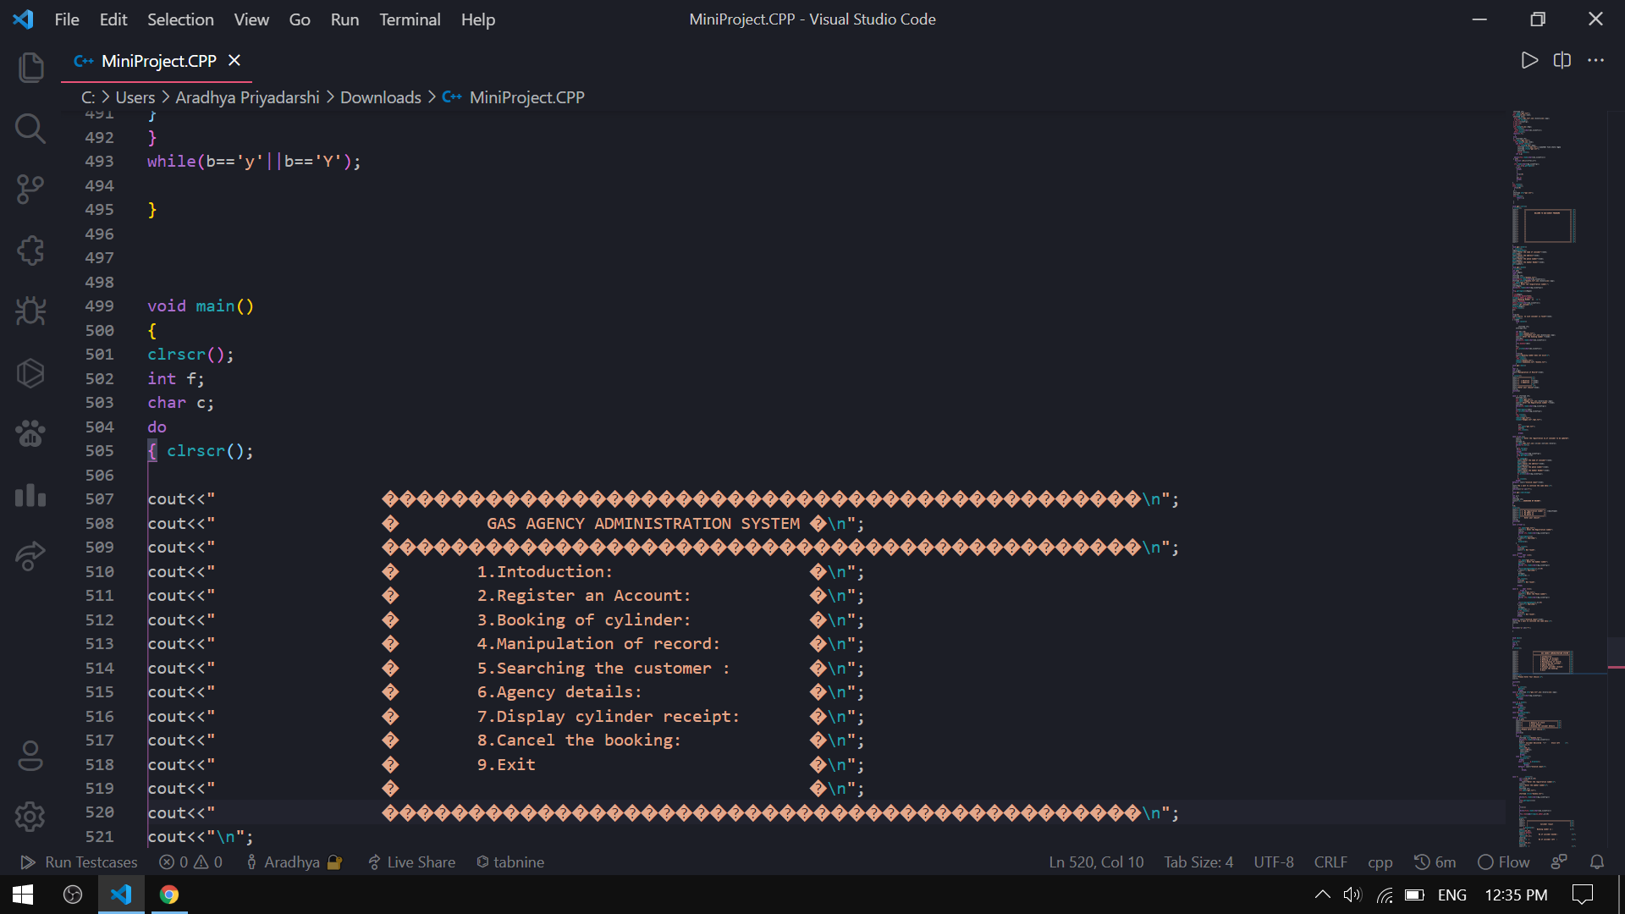

Slide 42
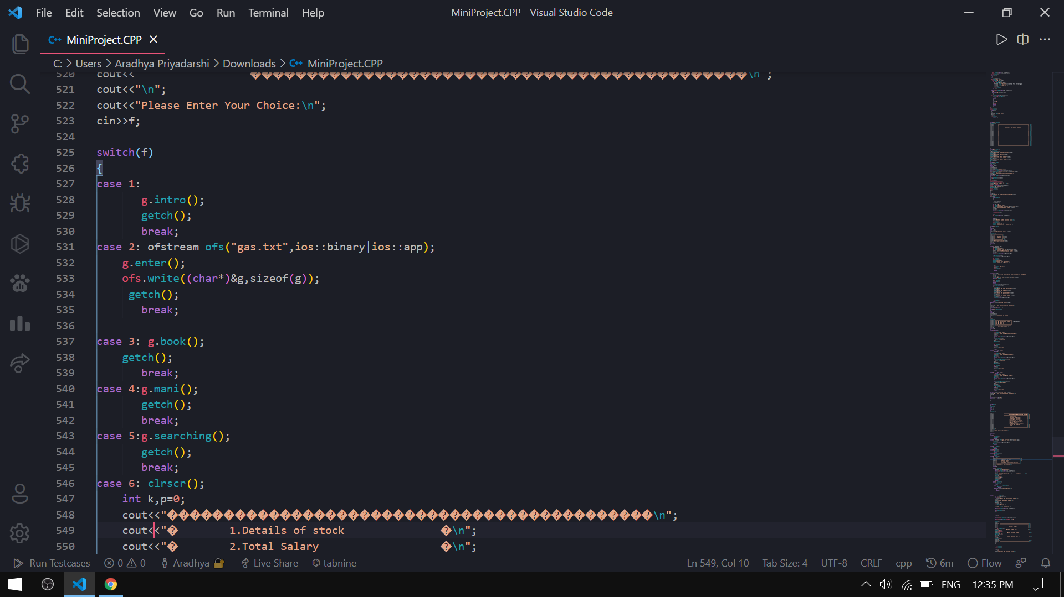

Slide 43
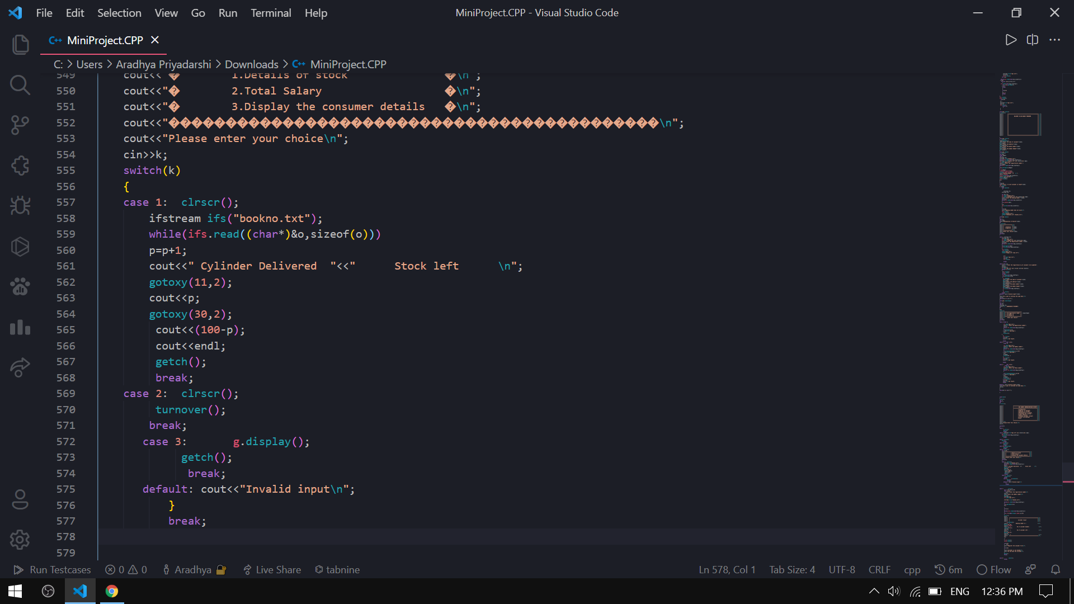

Slide 44
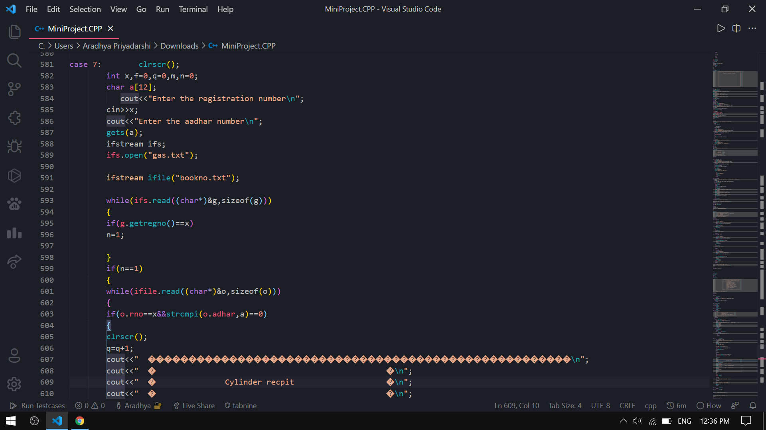

Slide 45
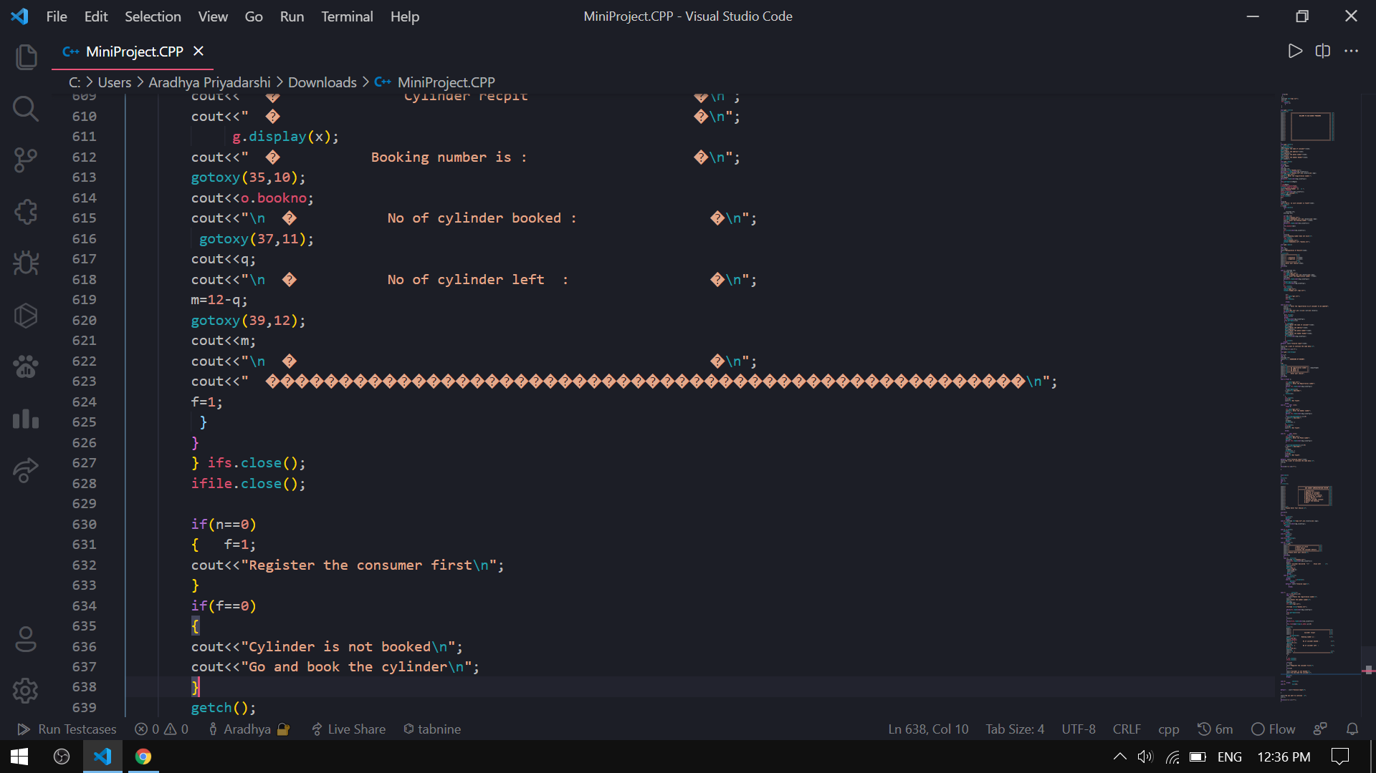

Slide 46
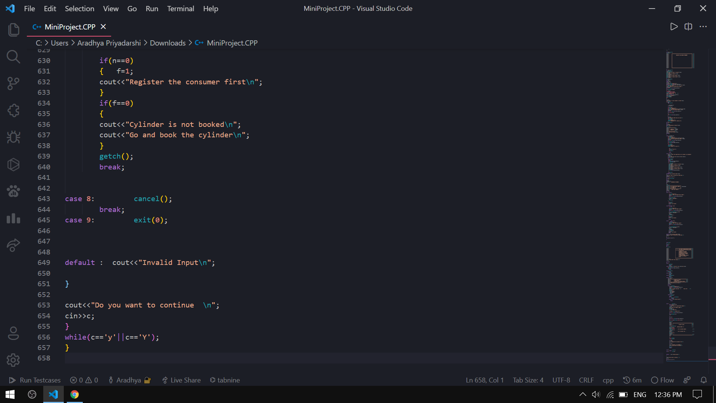

Slide 47
Thank You ☺

